Slide 1
Text Classification and Naive Bayes
Sentiment and Binary Naive Bayes

Slide 2
Let's do a worked sentiment example!

Slide 3
A worked sentiment example
Prior from training:
P(-) = 3/5
P(+) = 2/5
Drop "with"
Likelihoods from training:
Scoring the test set:

Slide 4
Optimizing for sentiment analysis
For tasks like sentiment, word occurrence is more important than word frequency.
The occurrence of the word fantastic tells us a lot
The fact that it occurs 5 times may not tell us much more.
Binary multinominal naive bayes, or binary NB
Clip our word counts at 1
Note: this is different than Bernoulli naive bayes; see the textbook at the end of the chapter.

Slide 5
Binary Multinomial Naïve Bayes: Learning
From training corpus, extract Vocabulary
Calculate P(c_{j}) terms
For each c_{j} in C do
docs_{j} ← all docs with class =c_{j}
Calculate P(w_{k} | c_{j}) terms
Text_{j} ← single doc containing all docs_{j}
For each word w_{k} in Vocabulary
n_{k} ← # of occurrences of w_{k} in Text_{j}
Remove duplicates in each doc:
For each word type w in doc_{j}
Retain only a single instance of w

Slide 6
Binary Multinomial Naive Bayes on a test document d
First remove all duplicate words from d
Then compute NB using the same equation:

Slide 7
Binary multinominal naive Bayes
Counts can still be 2! Binarization is within-doc!

Slide 8
Text Classification and Naive Bayes
More on Sentiment Classification

Slide 9
Sentiment Classification: Dealing with Negation
I really like this movie
I really don't like this movie
Negation changes the meaning of "like" to negative.
Negation can also change negative to positive-ish
Don't dismiss this film
Doesn't let us get bored

Slide 10
Sentiment Classification: Dealing with Negation
Das, Sanjiv and Mike Chen. 2001. Yahoo! for Amazon: Extracting market sentiment from stock message boards. In Proceedings of the Asia Pacific Finance Association Annual Conference (APFA).
Bo Pang, Lillian Lee, and Shivakumar Vaithyanathan. 2002. Thumbs up? Sentiment Classification using Machine Learning Techniques. EMNLP-2002, 79—86.
Simple baseline method:
Add NOT_ to every word between negation and following punctuation:
didn’t like this movie , but I
didn’t NOT_like NOT_this NOT_movie but I

Slide 11
Sentiment Classification: Lexicons
Sometimes pre-built word lists work magic
Called lexicons
There are various publically available lexicons

Slide 12
MPQA Subjectivity Cues Lexicon
Theresa Wilson, Janyce Wiebe, and Paul Hoffmann (2005). Recognizing Contextual Polarity in
Phrase-Level Sentiment Analysis. Proc. of HLT-EMNLP-2005.
Riloff and Wiebe (2003). Learning extraction patterns for subjective expressions. EMNLP-2003.
Home page https://mpqa.cs.pitt.edu/lexicons/subj_lexicon/
6885 words from 8221 lemmas, annotated for intensity (strong/weak)
2718 positive
4912 negative
+ : admirable, beautiful, confident, dazzling, ecstatic, favor, glee, great
− : awful, bad, bias, catastrophe, cheat, deny, envious, foul, harsh, hate

Slide 13
The General Inquirer
Philip J. Stone, Dexter C Dunphy, Marshall S. Smith, Daniel M. Ogilvie. 1966. The General Inquirer: A Computer Approach to Content Analysis. MIT Press
Home page: http://www.wjh.harvard.edu/~inquirer
List of Categories: http://www.wjh.harvard.edu/~inquirer/homecat.htm
Spreadsheet: http://www.wjh.harvard.edu/~inquirer/inquirerbasic.xls
Categories:
Positiv (1915 words) and Negativ (2291 words)
Strong vs Weak, Active vs Passive, Overstated versus Understated
Pleasure, Pain, Virtue, Vice, Motivation, Cognitive Orientation, etc
Free for Research Use

Slide 14
Bing Liu Opinion Lexicon
Minqing Hu and Bing Liu. Mining and Summarizing Customer Reviews. ACM SIGKDD-2004.
Bing Liu's Page on Opinion Mining
http://www.cs.uic.edu/~liub/FBS/opinion-lexicon-English.rar
6786 words
2006 positive
4783 negative

Slide 15
Using Lexicons in Sentiment Classification
Add a feature that gets a count whenever a word from the lexicon occurs
E.g., a feature called "this word occurs in the positive lexicon" or "this word occurs in the negative lexicon"
Now all positive words (good, great, beautiful, wonderful) or negative words count for that feature.
Using 1-2 features isn't as good as using all the words.
But when training data is sparse or not representative of the test set, dense lexicon features can help

Slide 16
Naive Bayes in Other tasks: Spam Filtering
SpamAssassin Features:
Mentions millions of (dollar) ((dollar) NN,NNN,NNN.NN)
From: starts with many numbers
Subject is all capitals
HTML has a low ratio of text to image area
"One hundred percent guaranteed"

Slide 17
Naïve Bayes in Language ID
Determining what language a piece of text is written in.
Features based on character n-grams do very well
Important to train on lots of varieties of each language (world English, etc)

Slide 18
Text Classification and Naïve Bayes
Precision, Recall, and F measure

Slide 19
Evaluation
Let's consider just binary text classification tasks
Imagine you're the CEO of Delicious Pie Company
You want to know what people are saying about your pies
So you build a "Delicious Pie" tweet detector
Positive class: tweets about Delicious Pie Co
Negative class: all other tweets

Slide 20
The 2-by-2 confusion matrix

Slide 21
Evaluation: Accuracy
Why don't we use accuracy as our metric?
Imagine we saw 1 million tweets
100 of them talked about Delicious Pie Co.
999,900 talked about something else
We could build a dumb classifier that just labels every tweet "not about pie"
It would get 99.99% accuracy!!! Wow!!!!
But useless! Doesn't return the comments we are looking for!
That's why we use precision and recall instead

Slide 22
Evaluation: Precision
% of items the system detected (i.e., items the system labeled as positive) that are in fact positive (according to the human gold labels)

Slide 23
Evaluation: Recall
% of items actually present in the input that were correctly identified by the system.

Slide 24
Why Precision and recall
Our dumb pie-classifier
Just label nothing as "about pie"
Accuracy=99.99%
but
Recall = 0
(it doesn't get any of the 100 Pie tweets)
Precision and recall, unlike accuracy, emphasize true positives:
finding the things that we are supposed to be looking for.

Slide 25
A combined measure: F
F measure: a single number that combines P and R:
We almost always use balanced F₁ (i.e., β = 1)

Slide 26
Development Test Sets ("Devsets") and Cross-validation
Train on training set, tune on devset, report on testset
This avoids overfitting (‘tuning to the test set’)
More conservative estimate of performance
But paradox: want as much data as possible for training, and ad much for dev; how to split?
Training set
Development Test Set
Test Set

Slide 27
Cross-validation: multiple splits
Pool results over splits, Compute pooled dev performance

Slide 28
Text Classification and Naive Bayes
Evaluation with more than two classes

Slide 29
Confusion Matrix for 3-class classification

Slide 30
How to combine P/R from 3 classes to get one metric
Macroaveraging:
compute the performance for each class, and then average over classes
Microaveraging:
collect decisions for all classes into one confusion matrix
compute precision and recall from that table.

Slide 31
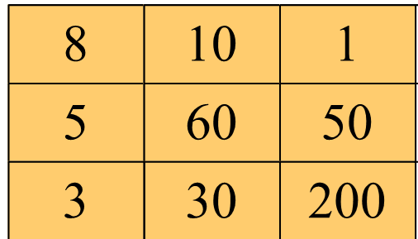
Macroaveraging and Microaveraging

Slide 32
Text Classification and Naive Bayes
Avoiding Harms in Classification

Slide 33
Harms in sentiment classifiers
Kiritchenko and Mohammad (2018) found that most sentiment classifiers assign lower sentiment and more negative emotion to sentences with African American names in them.
This perpetuates negative stereotypes that associate African Americans with negative emotions

Slide 34
Harms in toxicity classification
Toxicity detection is the task of detecting hate speech, abuse, harassment, or other kinds of toxic language
But some toxicity classifiers incorrectly flag as being toxic sentences that are non-toxic but simply mention identities like blind people, women, or gay people.
This could lead to censorship of discussion about these groups.

Slide 35
What causes these harms?
Can be caused by:
Problems in the training data; machine learning systems are known to amplify the biases in their training data.
Problems in the human labels
Problems in the resources used (like lexicons)
Problems in model architecture (like what the model is trained to optimized)
Mitigation of these harms is an open research area
Meanwhile: model cards

Slide 36
Model Cards
(Mitchell et al., 2019)
For each algorithm you release, document:
training algorithms and parameters
training data sources, motivation, and preprocessing
evaluation data sources, motivation, and preprocessing
intended use and users
model performance across different demographic or other groups and environmental situations

Slide 37
Language Modeling
Evaluation and Perplexity

Slide 38
Evaluation: How good is our model?
Does our language model prefer good sentences to bad ones?
Assign higher probability to “real” or “frequently observed” sentences
Than “ungrammatical” or “rarely observed” sentences?
We train parameters of our model on a training set.
We test the model’s performance on data we haven’t seen.
A test set is an unseen dataset that is different from our training set, totally unused.
An evaluation metric tells us how well our model does on the test set.

Slide 39
Extrinsic evaluation of N-gram models
Best evaluation for comparing models A and B
Put each model in a task
spelling corrector, speech recognizer, MT system
Run the task, get an accuracy for A and for B
How many misspelled words corrected properly

Slide 40
Difficulty of extrinsic (in-vivo) evaluation of N-gram models
Extrinsic evaluation
Time-consuming; can take days or weeks
So
Sometimes use intrinsic evaluation: perplexity
Bad approximation
unless the test data looks just like the training data

Slide 41
Intuition of Perplexity
mushrooms 0.1
pepperoni 0.1
anchovies 0.01
….
fried rice 0.0001
….
and 1e-100
The Shannon Game:
How well can we predict the next word?
Unigrams are terrible at this game. (Why?)
A better model of a text
is one which assigns a higher probability to the word that actually occurs
I always order pizza with cheese and ____
The 33rd President of the US was ____
I saw a ____

Slide 42
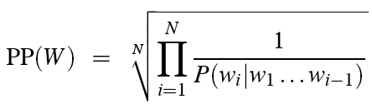
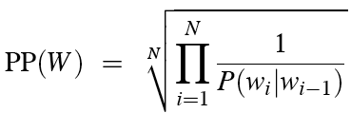
Perplexity
The best language model is one that best predicts an unseen test set
Gives the highest P(sentence)
Perplexity is the inverse probability of the test set, normalized by the number of words:
Chain rule:
For bigrams:
Minimizing perplexity is the same as maximizing probability

Slide 43
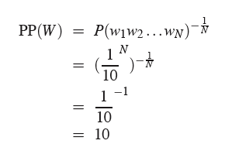
Perplexity as branching factor
Let’s suppose a sentence consisting of random digits
What is the perplexity of this sentence according to a model that assign P=1/10 to each digit?

Slide 44
Lower perplexity = better model
Training 38 million words, test 1.5 million words, WSJ
N-gram Order | Unigram | Bigram | Trigram
Perplexity | 962 | 170 | 109

Slide 45
Language Modeling
Interpolation, Backoff, and Web-Scale LMs

Slide 46
Backoff and Interpolation
Sometimes it helps to use less context
Condition on less context for contexts you haven’t learned much about
Backoff:
use trigram if you have good evidence,
otherwise bigram, otherwise unigram
Interpolation:
mix unigram, bigram, trigram
Interpolation works better

Slide 47
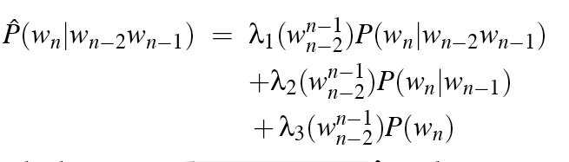
Linear Interpolation
Simple interpolation
Lambdas conditional on context:

Slide 48
How to set the lambdas?
Use a held-out corpus
Choose λs to maximize the probability of held-out data:
Fix the N-gram probabilities (on the training data)
Then search for λs that give largest probability to held-out set:
Training Data
Held-Out
Test
Data

Slide 49
Unknown words: Open versus closed vocabulary tasks
If we know all the words in advanced
Vocabulary V is fixed
Closed vocabulary task
Often we don’t know this
Out Of Vocabulary = OOV words
Open vocabulary task
Instead: create an unknown word token <UNK>
Training of <UNK> probabilities
Create a fixed lexicon L of size V
At text normalization phase, any training word not in L changed to <UNK>
Now we train its probabilities like a normal word
At decoding time
If text input: Use UNK probabilities for any word not in training

Slide 50
Huge web-scale n-grams
How to deal with, e.g., Google N-gram corpus
Pruning
Only store N-grams with count > threshold.
Remove singletons of higher-order n-grams
Entropy-based pruning
Efficiency
Efficient data structures like tries
Bloom filters: approximate language models
Store words as indexes, not strings
Use Huffman coding to fit large numbers of words into two bytes
Quantize probabilities (4-8 bits instead of 8-byte float)

